Slide 1

Dense Motion Analysis
CSCI 4360/6360 Data Science II

Slide 2
Motion analysis
Our world is in motion

Slide 3
Motion analysis
Core problem in computer vision

Slide 4
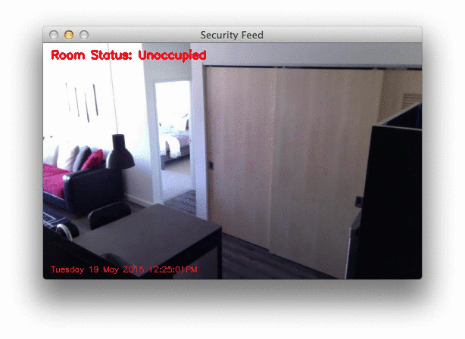
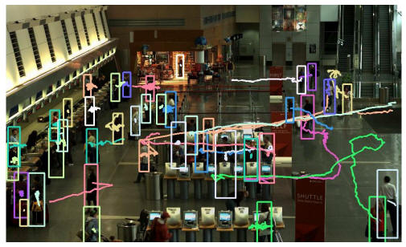
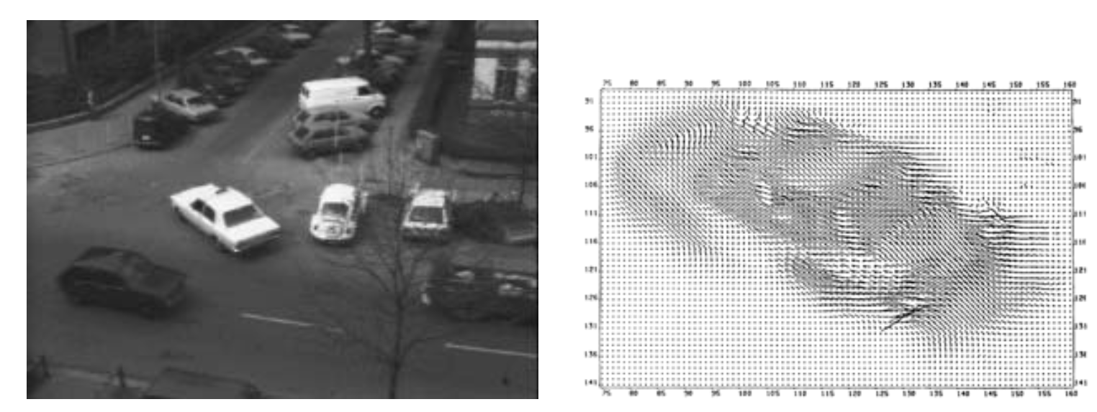
Motion analysis
Object tracking
Trajectory analysis
Object finding
Video enhancement, stabilization, 3D reconstruction, object recognition

Slide 5
Perception vs Representation
We can perceive motion where none exists, or not perceive motion where motion exists

Slide 6
Perception vs Representation
(I promise this is
a static image)

Slide 7
Perception vs Representation
Other examples

Slide 8
Perception vs Representation
Shapeless or transparent objects, or limited sight, are problematic
Computer would not see motion in the previous images (which is good)
… computer doesn’t “see” in the human sense
Point being: computers only analyze motion of opaque, solid objects
Key: motion representation

Slide 9
Representing Motion
We perceive optic flow
Pattern of flow (vectors)
Ecological optics – J.J. Gibson
Notes:
We intuitively process these flow vectors without realizing it, but it gives rise to a robust definition of motion.

Slide 10
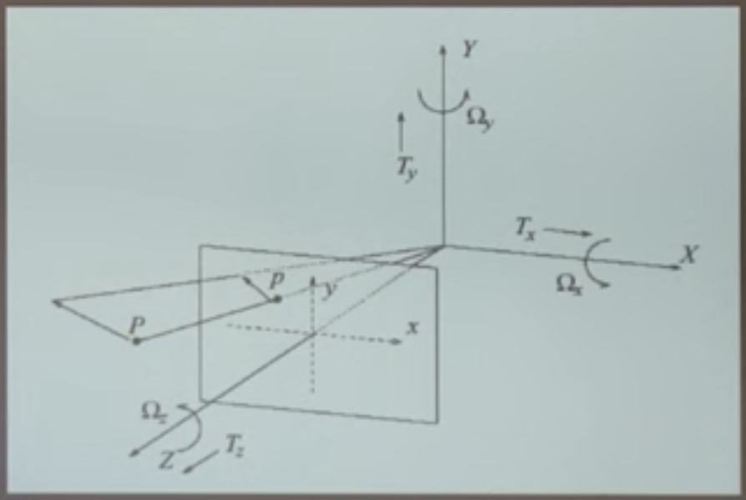
Representing Motion
Deviations
3D motion of object is represented as 2D projection—losing 1 dimension of information
Optical flow = 2D velocity describing apparent motion

Slide 11
Thought Experiment 1
We have a matte ball, rotating
What does the 2D motion field look like?
What does the 2D optical flow field look like?

Slide 12
Thought Experiment 2
We have a matte ball, stationary
What does the 2D motion field look like?
What does the 2D optical flow field look like?
Notes:
Two cases where 2D motion field and 2D optical flow field differ!
In both cases, optical flow field is stationary—that’s a problem

Slide 13
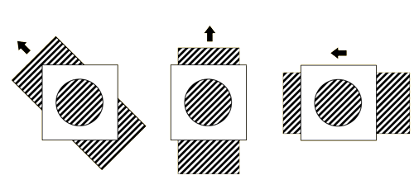
Just to throw a wrench in things…
The Aperture Problem: lighting is not the only source of error.
Notes:
Through the aperture, they all appear to have the same motion; taking outside information into account (information the computer wouldn’t have), they of course are moving in different directions.

Slide 14
Aside
With all these limitations and pitfalls, it’s important to keep the following items in mind (with thanks to Dr. Michael Black):
We are, more or less, intentionally forgetting any physics we might know
We are dealing with images
We’re hoping the 2D flow is related to the structure of the world and can be a viable proxy for the motion field
Fixing the above is important—you could work on it!
Notes:
Physics may and likely does indeed play a role and we can (you can!) come back to that
For now, we’re ignoring optics, materials, surfaces, and so on
Dealing only with images
In a very real sense, the motion field is a latent variable; we’re using optical flow as a stand-in approximation. As the previous slides have pointed out, this approximation has some fatal flaws to be aware of. But it also works well a lot of the time.
These are open problems in dense motion estimation and analysis, though we won’t be fixing them today ☺

Slide 15

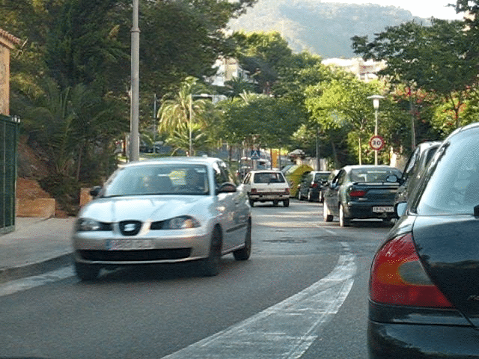
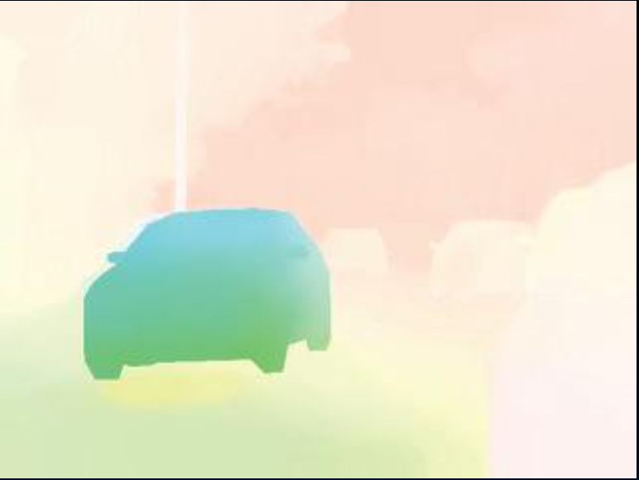
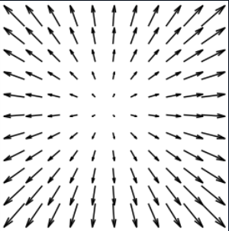
Optical Flow
Motion, or displacement, at all pixels
Magnitude: saturation
Orientation: hue

Slide 16
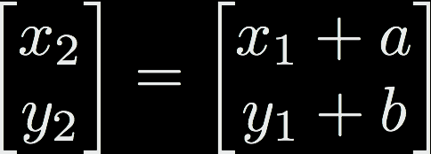
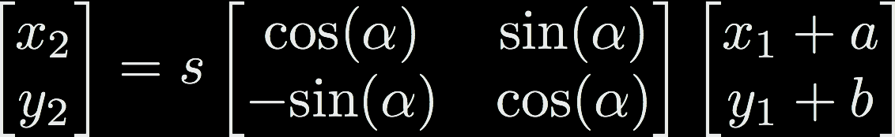
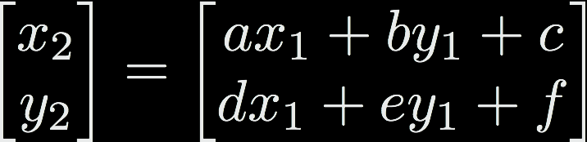
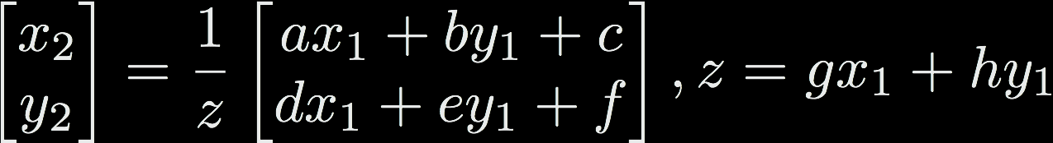
Optical Flow Goals
Find a mapping for each pixel (x₁, y₁) -> (x₂, y₂)
Seems simple enough…?
Motion types
Translation
Similarity
Affine
Homography

Slide 17
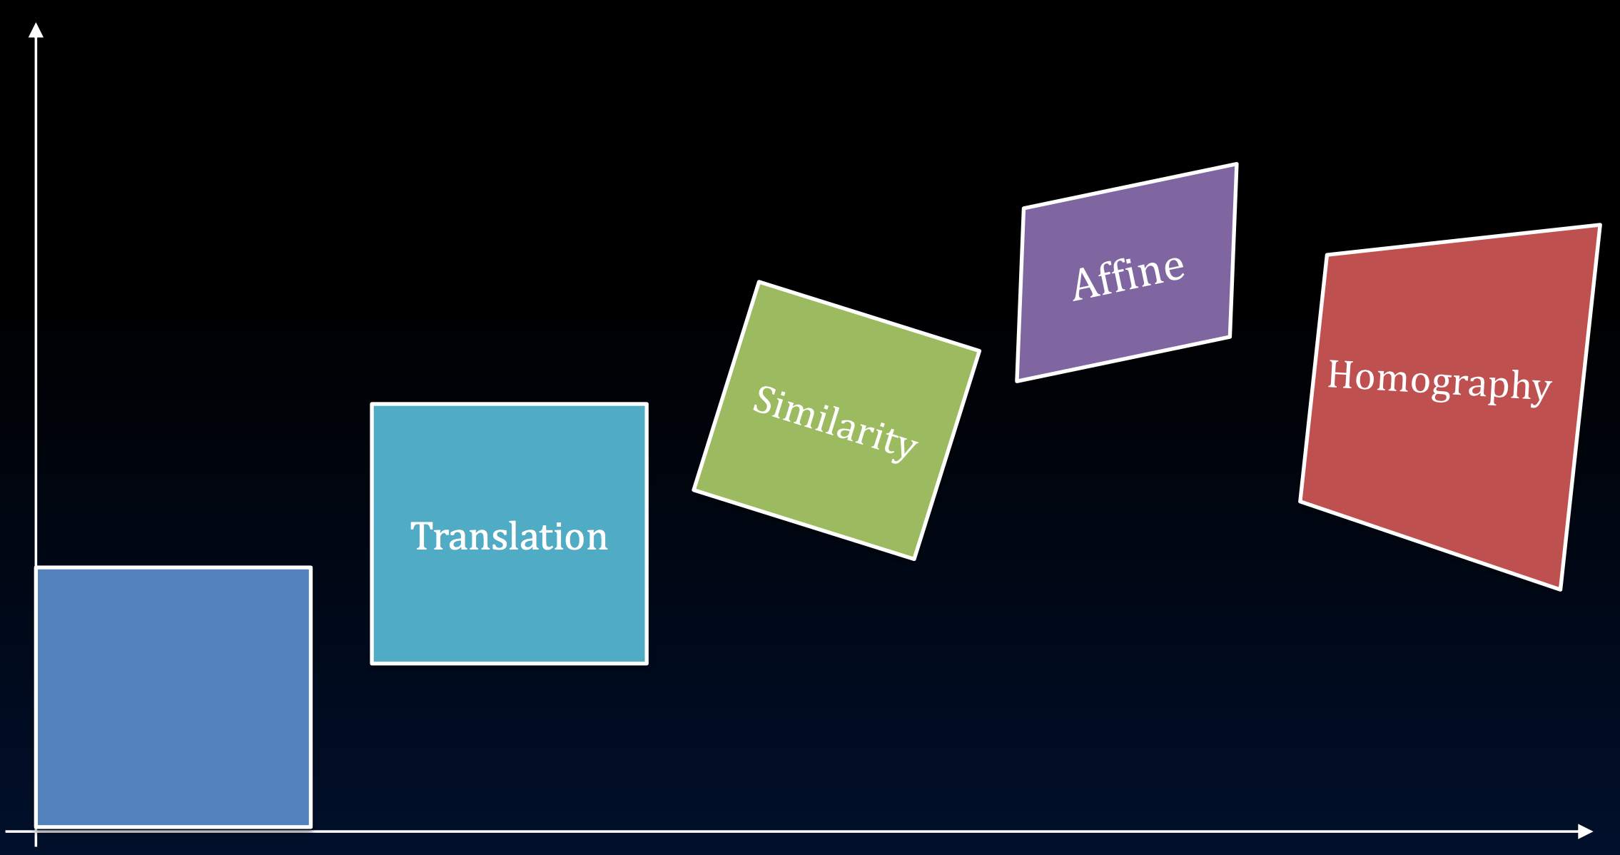
Motion Types
This is known as parametric motion: powerful in its expressivity, but limited in its ability to describe arbitrary motion in videos.

Slide 18


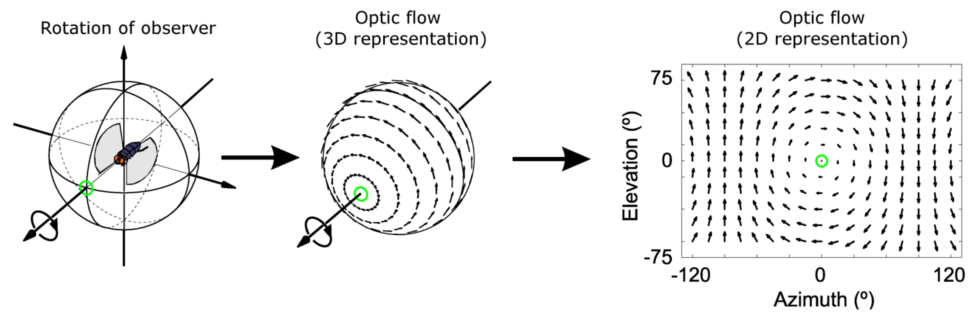
Optical Flow Definition
Image pixel value at time t and location x = (x, y)
Horizontal u and vertical v components of the flow
Notes:
Instead of parametric optical flow, we often use the flow fields we alluded to earlier (this is where dense optical flow comes in).

Slide 19
Optical Flow Assumptions
Brightness Constancy
Any one patch from frame 1 should look more or less the same as a corresponding spatial patch from frame 2
Notes:
The image at position and time looks like the image at time t + 1, just that the pixels are offset by u and v
This is a fundamental assumption behind most optical flow programs

Slide 20
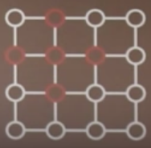


Optical Flow Assumptions
Spatial Smoothness
Neighboring pixels in an image are likely to belong to the same surface
Surfaces are mostly smooth
Neighboring pixels have similar flow
Notes:
Horizontal flow at u should look like horizontal flow at some neighboring pixel (i.e. one of its 4 or 8 direct neighbors)
i.e., spatial derivatives are 0

Slide 21
Objective Function
Brightness constancy (”data term”)
New developments?
Squared error implies Gaussian noise!

Slide 22
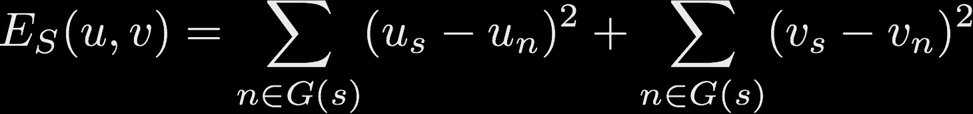
Objective Function
Spatial term for the flow fields u and v
New developments?
Flow field is smooth
Deviations from smooth are Gaussian
First-order smoothness is all that matters
Flow derivative is approximated by first differences

Slide 23
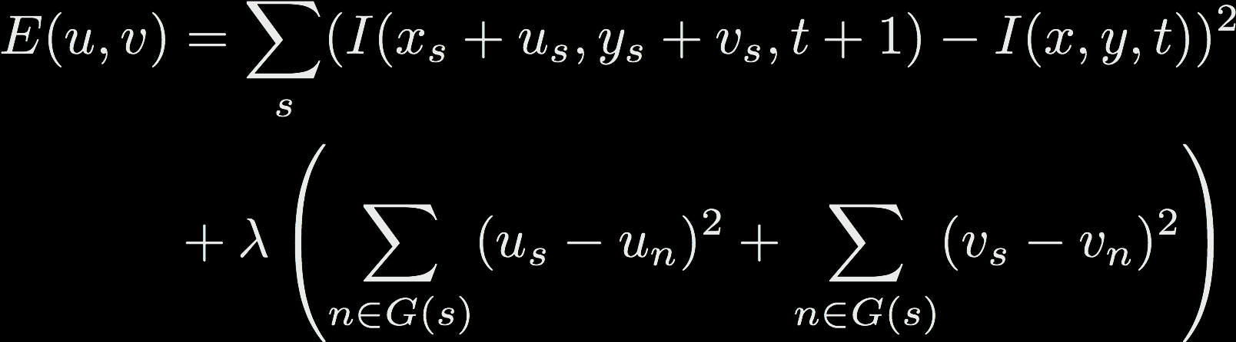
Objective Function
Notes:
Classic formulation of optical flow objective.
How do we solve it?

Slide 24
Objective Function
So to solve for flow field, we just take derivative, set to 0, and solve for u and v, right?
???
Notes:
Classic formulation of optical flow objective.
How do we solve it?
It’s not linear in u and v, so it’s not clear how to solve explicitly for them.
So when we want a linear approximation, what do we turn to?...

Slide 25
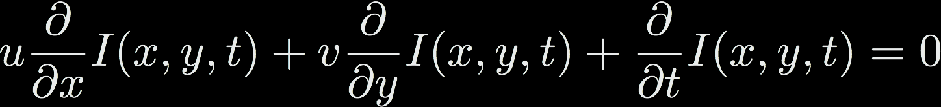
Linear approximation
Taylor series expansion
dx = u, dy = v, dt = 1
Notes:
1) Image at time t
2) plus partial derivatives in x, y, and t directions
3) And the image again from the original equation
4) These two cancel
5) So we’re left with these three terms
6) Which we write this way…

Slide 26

Constraint equation
…but really, we write it this way:
More new developments
Flow is small
Image is a differentiable function
First-order Taylor series is a good approximation
Notes:
Flow has to be small in order to make Taylor series approximation
Differentiable function? A discrete image is now a differentiable function?

Slide 27
Form of the constraint equation
One equation, two unknowns
A line
We know the solution is somewhere along the line
Ill-posed problem: hence, the Aperture Problem
Notes:
The solution to the constraint equation is AMBIGUOUS
- for a small region, we don’t necessarily have enough information to make a distinct decision on the flow
- in the graphic we can see the endpoints, so the solution is not ambiguous
- but since we’re looking in a small neighborhood of pixels to establish flow fields, we don’t see these endpoints

Slide 28
Nevertheless, they persisted
Horn and Schunck, 1981
Take partial derivatives with respect to u and v; set to 0
Notes:
These equations are already linearized (thanks to taylor series approximation)
You can stack the constraints of the derivatives into a system of linear equations and solve directly! Ax = b (A is large but sparse, easy to solve for b)

Slide 29
Revisiting assumptions
Many of the Horn & Schunck ‘81 problems can be attributed to the fact that they were attempting dense image processing on 1981 computers
Still, the problems outlined by the assumptions can cause problems in the real-world (aperture problem, ill-posed optimization, assumption of small motion, etc)
Lots of these assumptions are still outstanding problems but have been addressed, at least in part
(Check out the 2013 talk by Dr. Michael Black!)

Slide 30
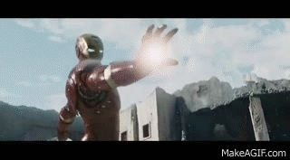
“Flow is small”
Have you ever seen a Marvel movie?

Slide 31
Coarse-to-fine
Build an image “pyramid”
Exactly how this is done varies considerably
Bottom line: flow calculated in original image is much smaller at top of pyramid (i.e., assumptions hold)
Most optical flow algorithms do something like this

Slide 32
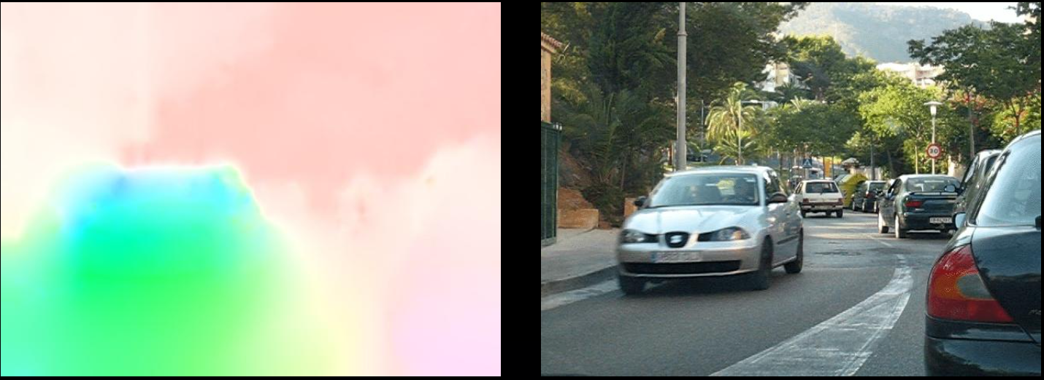
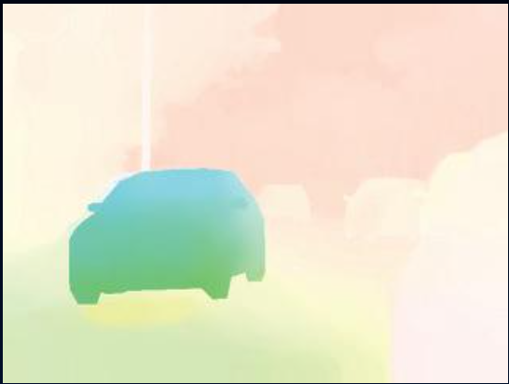
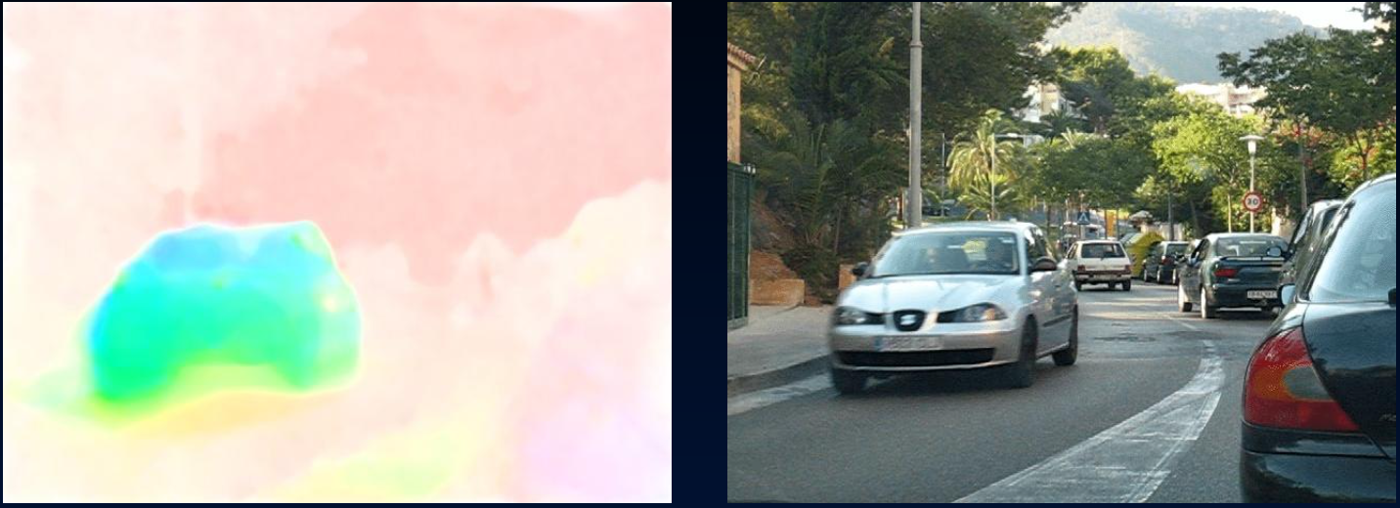
Coarse-to-fine
Original
This one “small” modification to Horn & Schunck actually gives pretty good results!
Ground
Truth
Coarse-to-fine

Slide 33
“Flow is smooth”
Does brightness constancy hold?
Are spatial derivatives of optical flow actually Gaussian?
As machine learning practitioners, how would we answer these questions?
Need ground truth—very recent developments
Notes:
Need graphics data
- could go to Hollywood and get it directly
- but of course they have no interest in it
There’s no camera that captures motion between pixels over time

Slide 34
Durien Open Movie Project
Sintel (full movie—go watch!)
Made with Blender
All assets openly available—including ground truth optical flow fields
1628 frames of ground truth flow
1024x436 resolution
max velocity over 100 ppf
separated into training/testing
Notes:
Problem solved, right?

Slide 35
CS Mantra
We solve one problem (need of ground-truth optical flow) by adding an additional abstraction layer (assume flow statistics of Sintel will generalize)
…which usually introduces a new problem
Will these flow statistics be at all useful for optical flow models outside of action movies?

Slide 36
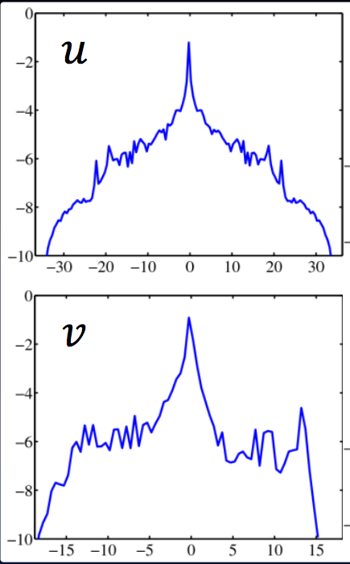
Flow Statistics
In general, optical flow fields are sparse (i.e., most flow fields are 0)
Horn and Schunck

Slide 37
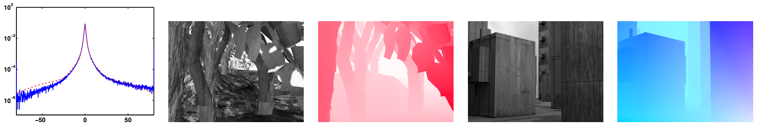
Flow Statistics
Using the flow statistics from training data, we can determine that brightness constancy usually holds
Spark peak at 0
Heavy tails are violations of brightness constancy
Notes:
What are possible violations of brightness constancy?
- reflection
- occlusion
- transparency
- etc

Slide 38
“Neighboring pixels move together”
Except when they don’t
Could consider these pixels as “spatial outliers”
But want to consider them as part of different surfaces with different motions

Slide 39
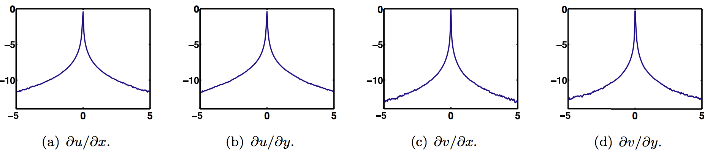
Spatial statistics
Spatial derivatives of the optical flow field u and v
Similar story: flow is usually smooth, but motion boundaries create have heavy tails

Slide 40
Markov Random Fields
Ground Truth
The heavy tails on the spatial statistics are why optical flow has such problems with object boundaries
Quadratic smoothness term in objective
Horn & Schunck [inadvertently?] kicked off 30+ years of research into Markov Random Fields
Need a “robust” formulation that can handle multiple surfaces moving distinctly from each other
Horn and Schunck

Slide 41
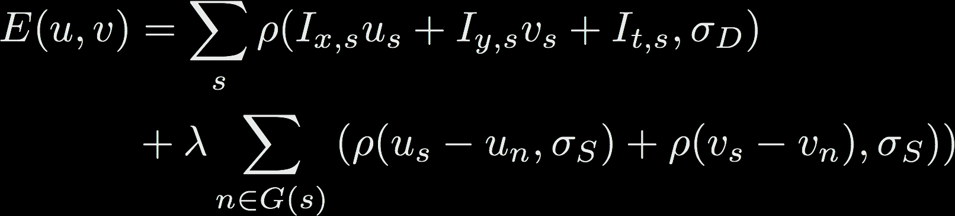
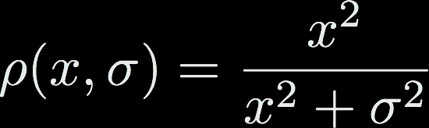
Robust Formulation
Replace quadratic terms in original energy function with a new error function that gives less weight to large errors
Note the rho functions and sigmas

Slide 42
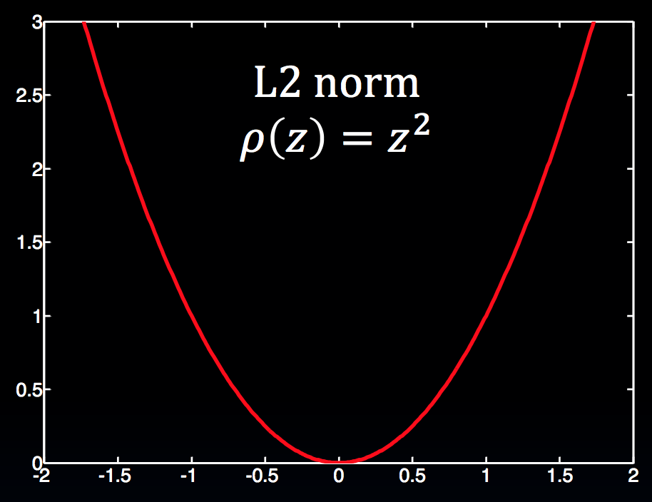
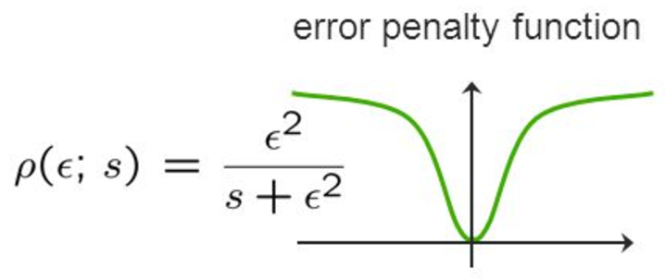
Robust Formulation
Previous L2 (squared error) is sensitive to outliers
Outliers = occasional large flow derivatives
New error function saturates at larger magnitudes
Is robust to outliers

Slide 43
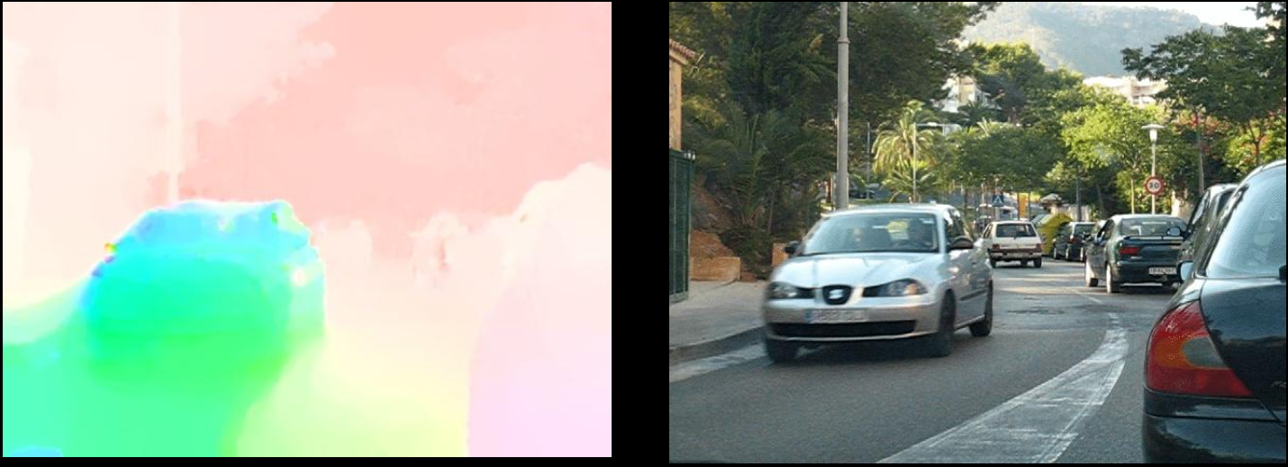
Robust Formulation
Object boundaries are considerably sharper
Success! Go home?
Horn and Schunck
Robust

Slide 44
Robust Formulation
Optimization is considerably more difficult
Non-linear in the flow term
No closed-form solution
Approaches
Gradient descent
Graduated non-convexity
Iteratively re-weighted least squares

Slide 45
Current Methods
Current methods employ a combination of
Coarse-to-fine (image pyramids)
Median filtering (convolutions)
Graduated non-convexity
Image pre-processing
Bicubic interpolation (sparse to dense)
Layers and segmentation (Sevilla-Lara et al 2016, CVPR)
Pyramid networks (Ranjan et al 2016, CVPR)
Deep convolutional networks (Dosovitskiy and Fischer et al 2015, ICCV)

Slide 46
Administrivia
Hope you enjoyed the snow days!
No idea how we’ll get caught up… oh well
AutoLab is UP AND RUNNING
As usual, SSL and email were the biggest time sinks
HW1 is still due by 11:59pm Tuesday, January 28
Click link in Discord to get access to the course
Some other date changes...
HW2 will come out on Jan 28 (due 2.5 weeks later, Feb 13)
HW3 will come out on Feb 11 (due 2.5 weeks later, Feb 27)
Advantages & Disadvantages
Notes:
Disadvantages:
- overlapping hw2 and hw3
- hw3 due on the same day as the midterm exam
Advantages
- no homework at all over spring break (hw4 comes out after we get back)
- only 2 homeworks in back half of course (+ final project, but NO FINAL EXAM)
- hw4 and hw5 do not overlap

Slide 47
References
Dr. Ce Liu’s Computer Vision course (lectures 19 and 20) http://people.csail.mit.edu/torralba/courses/6.869/6.869.computervision.htm
Dr. Richard Szeliski’s book (chapter 8) http://szeliski.org/Book/
Dr. Michael Black’s Optical Flow talk (2013) https://www.youtube.com/watch?v=tIwpDuqJqcE
Sun et al, “Learning Optical Flow”, ECCV 2008 http://people.seas.harvard.edu/~dqsun/publication/2008/ECCV2008.pdf

